Slide 1

Oracle Analytics Cloud
for MoH & Healthcare Researchers
Jakarta, August 1, 2025

Slide 2
Outline
1
Create Instance
2
Connect to Autonomous Database 23ai
3
Create Machine Learning Model
4
Sharing Model
5
Chat with Data Visualization

Slide 3
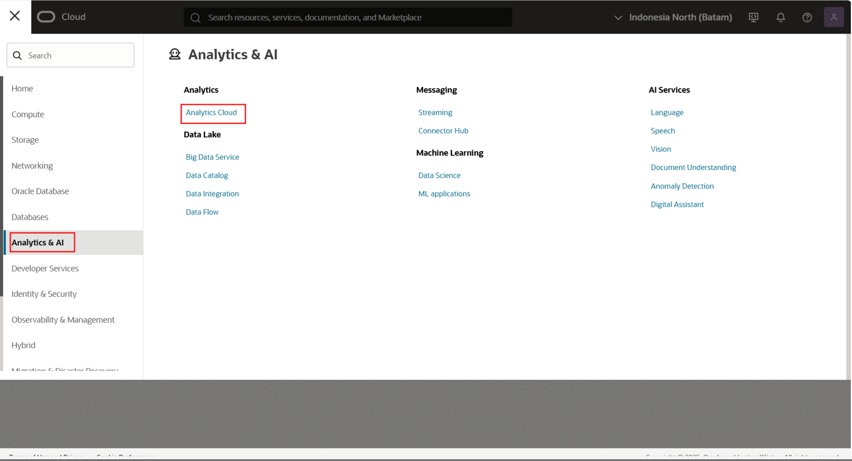
2
1
Select Analytics & AI
Select Analytics Cloud

Slide 4
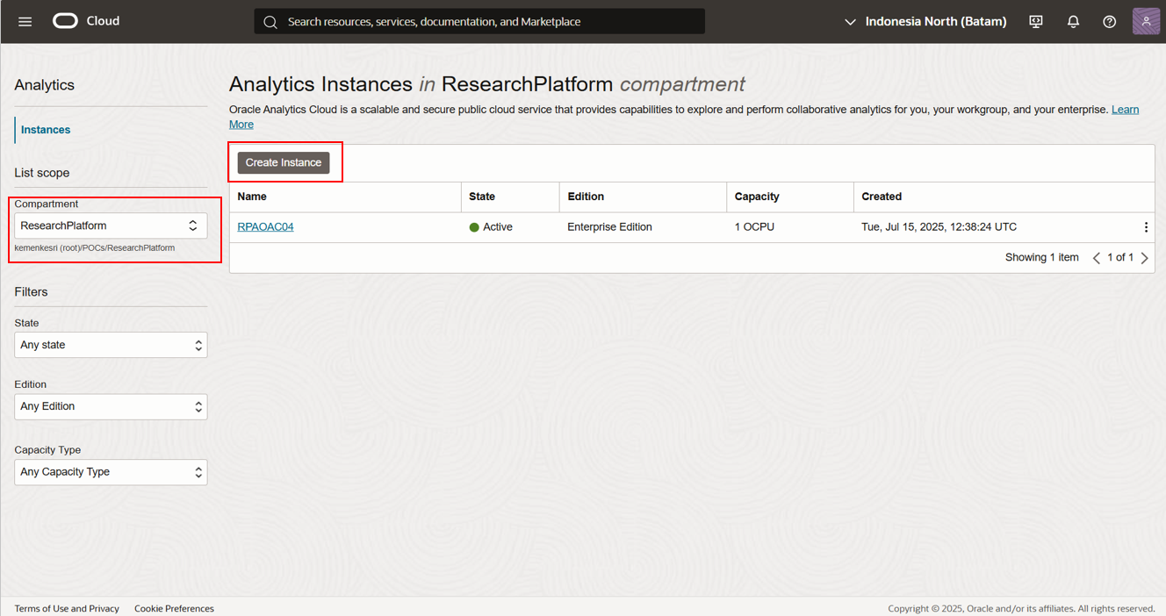
2
3
1
Choose Compartment
Make sure compartment is correct
Create Instance
Copyright © 2025, Oracle and KEMENKES - Confidential

Slide 5
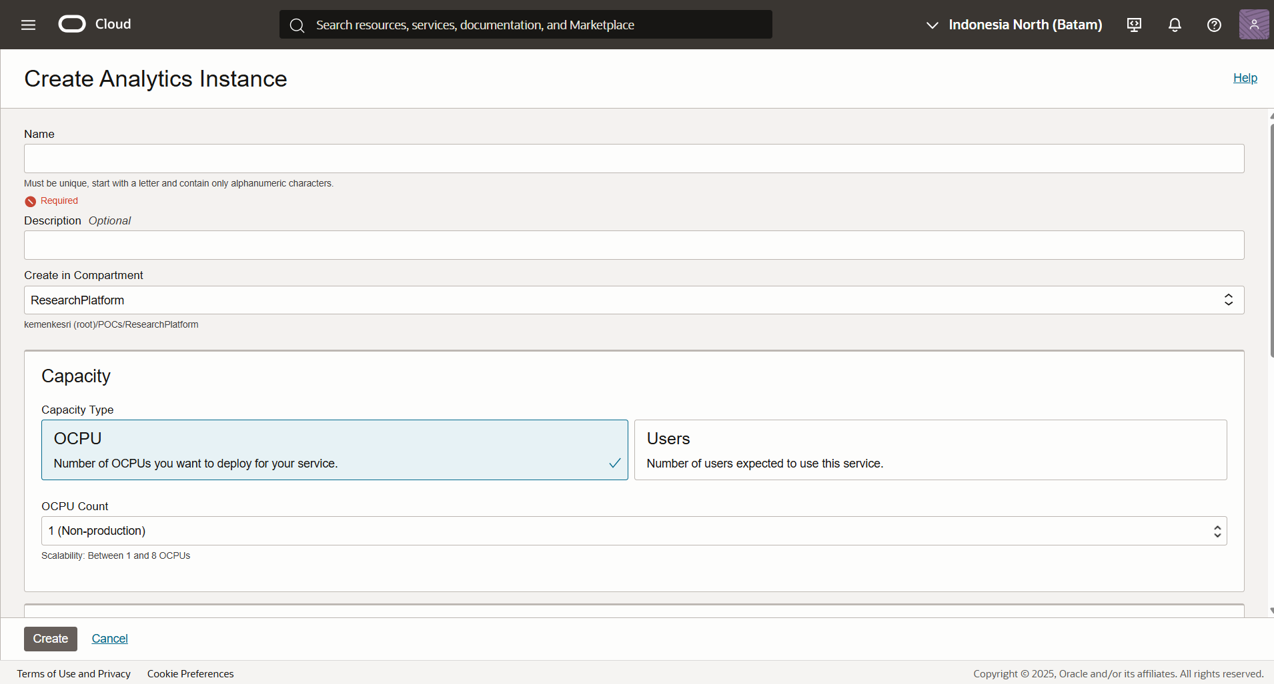
Enter a Name for the Analytics instance (must be unique and alphanumeric).
(Optional) Add a Description for easier identification.
Select the target Compartment where the instance will be created.
Under Capacity, choose Capacity Type (OCPU) and specify the OCPU Count (e.g., 1 Non-production).
Click Create to deploy the Analytics instance.

Slide 6
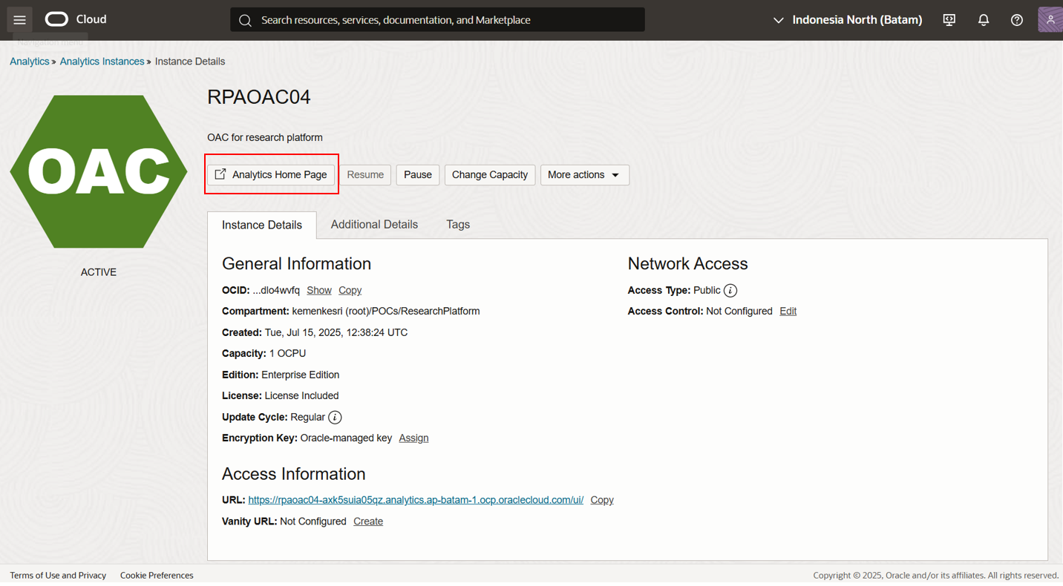
Click Analytics Home Page
Copyright © 2025, Oracle and KEMENKES - Confidential

Slide 7
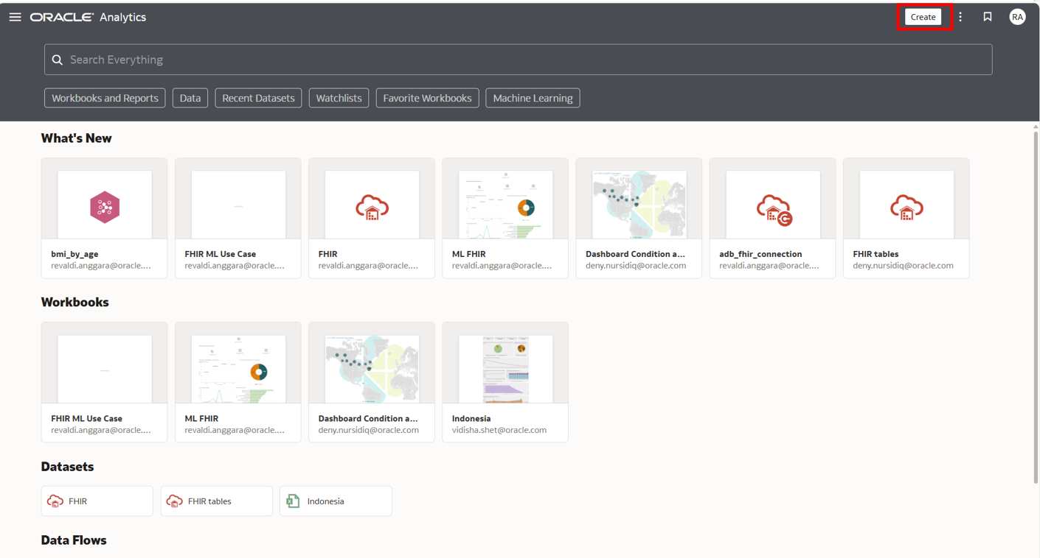
1. After logging in to Oracle Analytics Cloud, you will see the home dashboard with sections such as What's New, Workbooks, Datasets, and Data Flows.
2. To start a new analysis, click the Create button at the top-right corner of the page.
3. From the menu, choose whether you want to create a Project, Workbook, Dataset, or Data Flow.
Copyright © 2025, Oracle and KEMENKES - Confidential

Slide 8
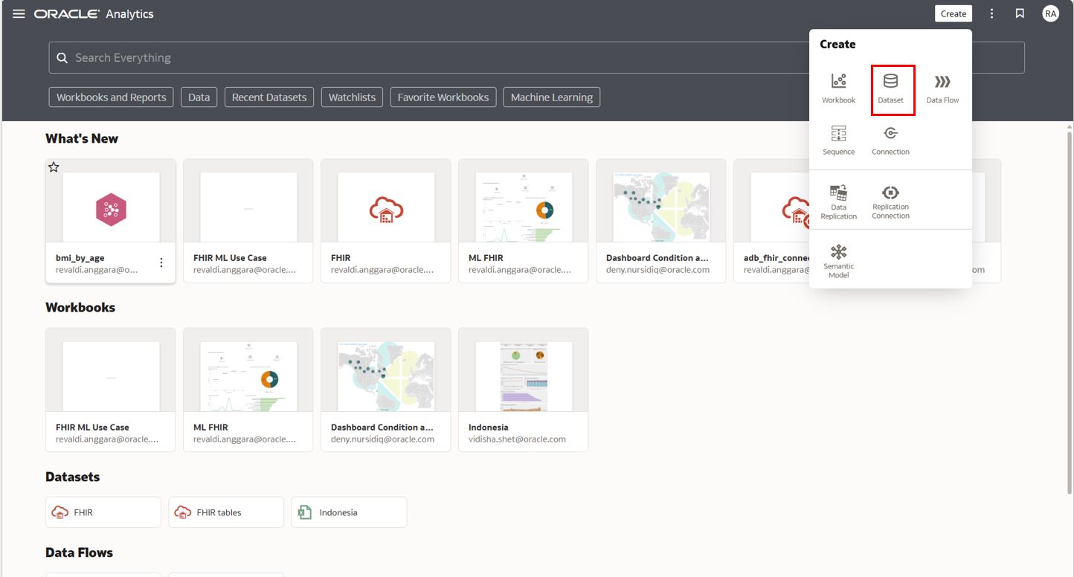
On the Oracle Analytics Cloud home page, click Create in the top-right corner.
From the dropdown menu, select Dataset to begin creating a new dataset.
Copyright © 2025, Oracle and KEMENKES - Confidential

Slide 9
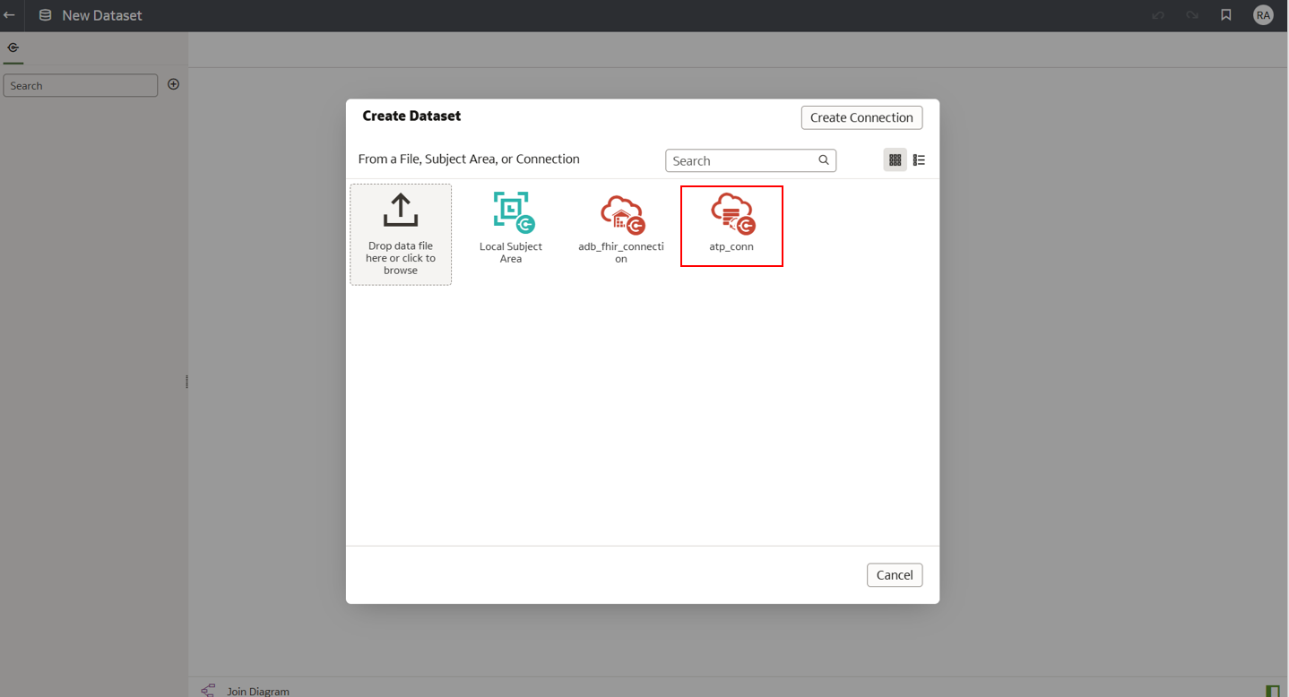
Connection from the same compartment (ResearchPlatform)
On the Create Dataset window, select the available database connection.
In this example, choose atp_conn to connect to the Autonomous Transaction Processing (ATP) database.
This connection is created within the same compartment (ResearchPlatform) ensuring data remains in the same environment.

Slide 10
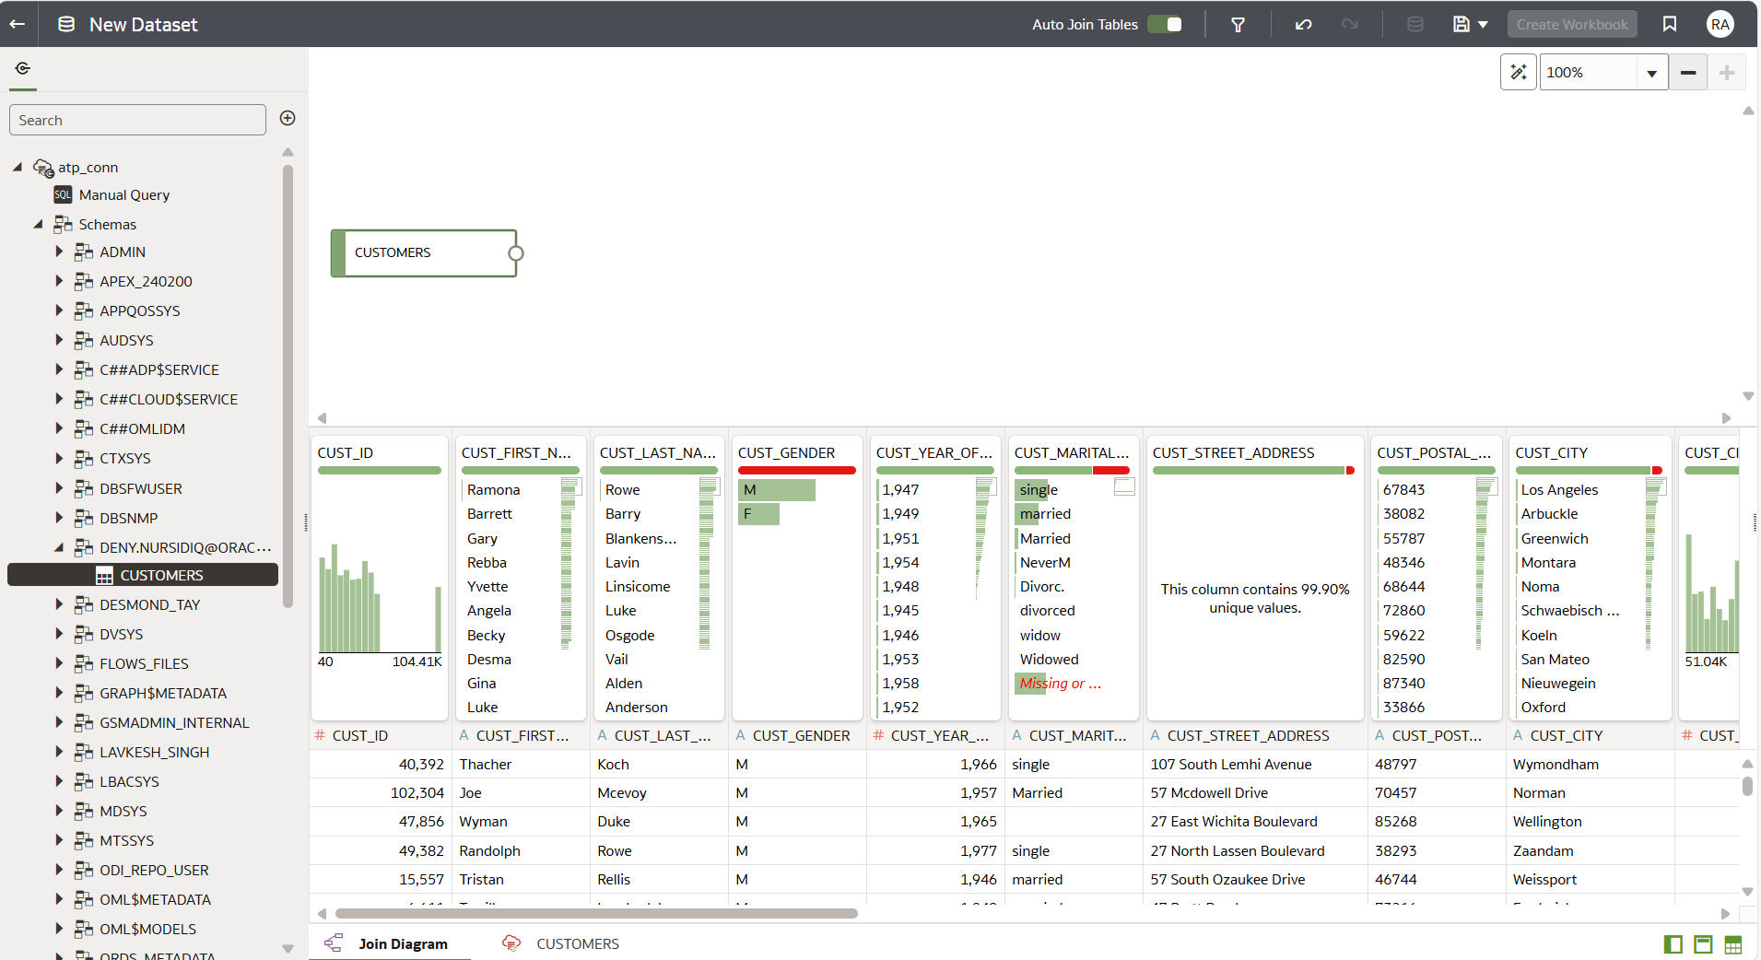
Click Admin
Drag n Drop Table into Canvas
Make Auto Join
Merapihkan workflow

Slide 11
3
4
1
2
Click Schemas/User – in this example, the user is deny.nursidiq@oracle.com.
Drag and Drop the desired table (e.g., CUSTOMERS) into the canvas area.
(Optional) Enable Auto Join if you want tables to be joined automatically.
(Optional, but recommended) Organize the workflow to keep the dataset structure clear and easy to follow.
Copyright © 2025, Oracle and KEMENKES - Confidential

Slide 12
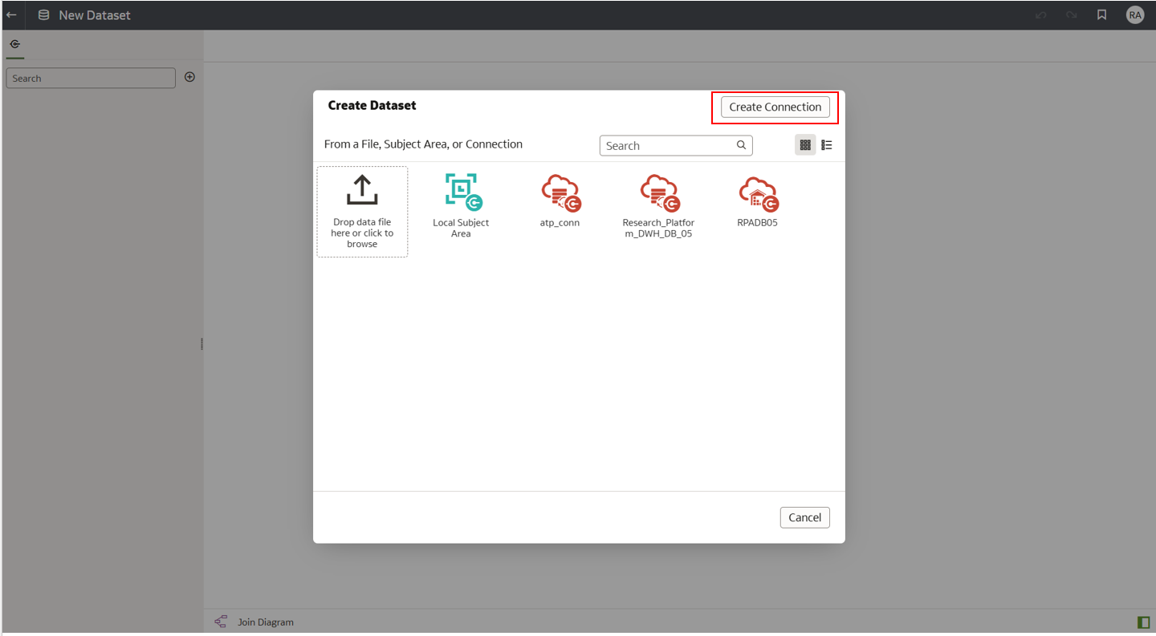
Connection from a different compartment (ResearchPlatform to MLModels) using Wallet
On the Create Dataset window, select the available database connection.
In this example, choose atp_conn to connect to the Autonomous Transaction Processing (ATP) database.
This connection is created from a different compartment (MLModels)
Copyright © 2025, Oracle and KEMENKES - Confidential

Slide 13
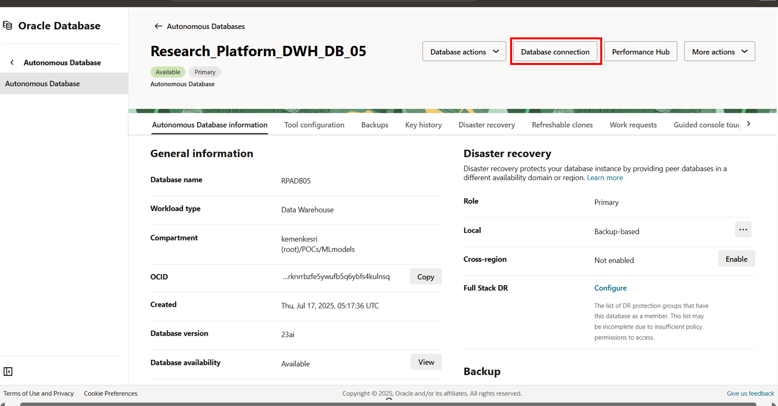

Slide 14
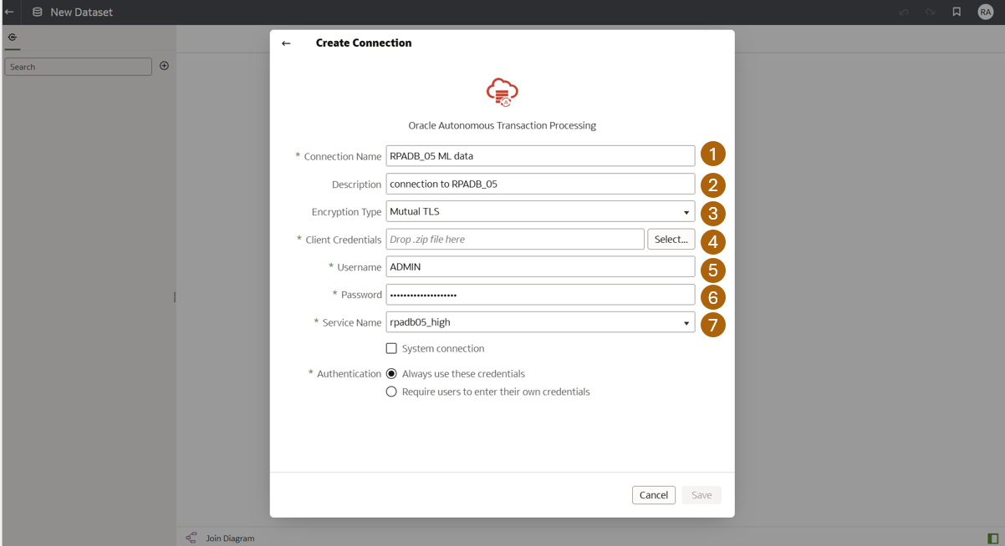
Connection Name → Enter a unique name for this connection (e.g., RPADB_05 for ML data).
Description → Provide a short description of the connection (e.g., connection to RPADB_05).
Encryption Type → Select Mutual TLS.
Client Credentials → Upload the .zip wallet file that was previously downloaded from the Autonomous Database connection.
Username → Enter the database username (e.g., ADMIN).
Password → Enter the corresponding database user password.
Service Name → Specify the service name, for example rpadb05_high.
Copyright © 2025, Oracle and KEMENKES - Confidential

Slide 15
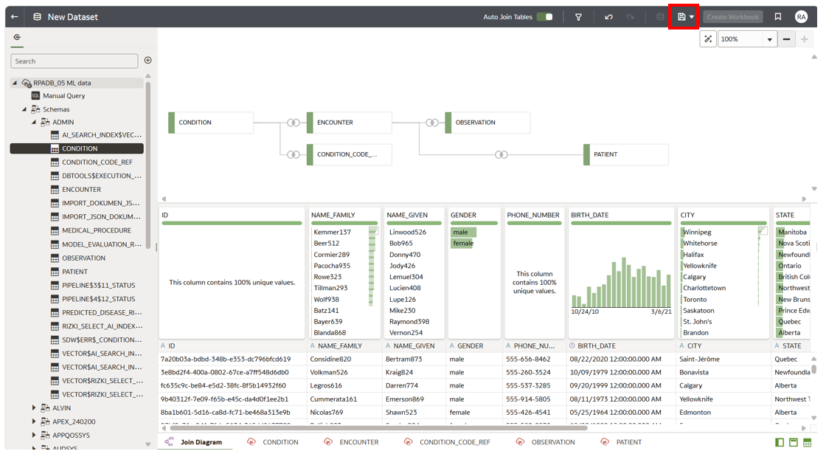
Data from RPADB_05 Compartment MLModels
Copyright © 2025, Oracle and KEMENKES - Confidential

Slide 16
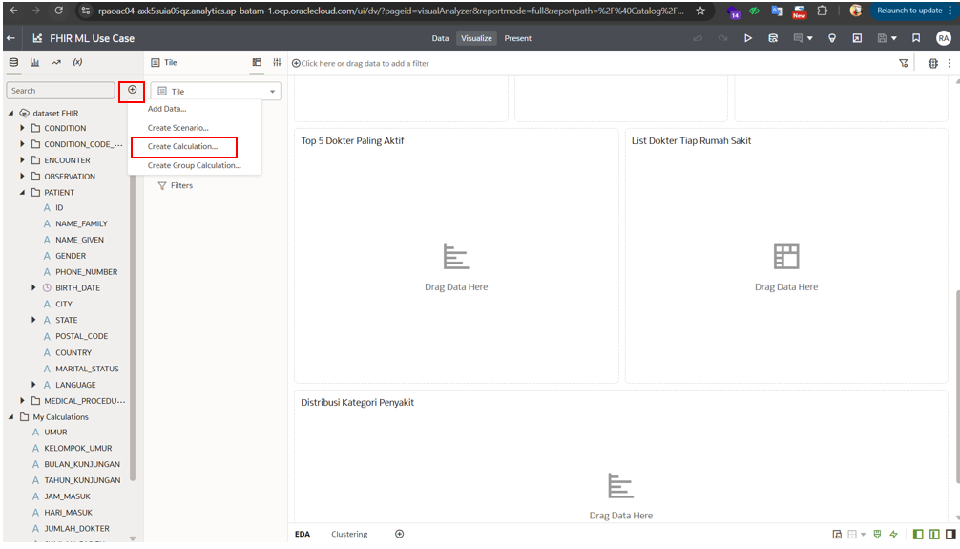
In Oracle Analytics Cloud, use Create Calculation to add custom fields that extend your dataset. The new fields will appear under My Calculations and can be dragged into the canvas to build visualizations and support deeper analysis.
Copyright © 2025, Oracle and KEMENKES - Confidential

Slide 17
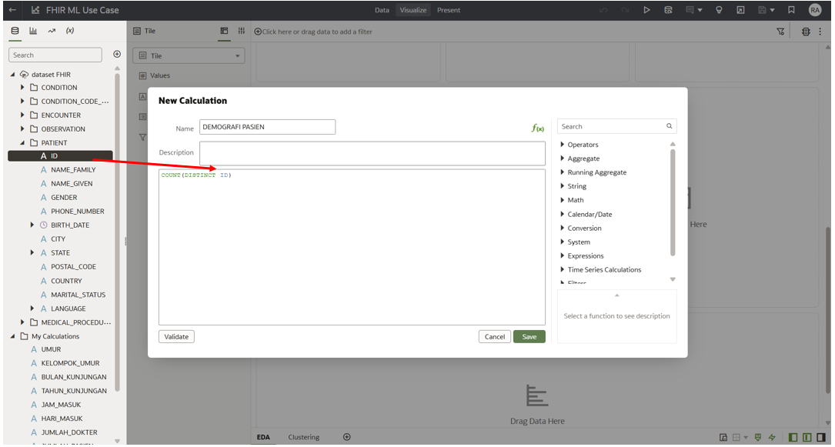
In the New Calculation dialog, enter a name for the calculation (e.g., DEMOGRAFI PASIEN). Then, define the formula using dataset fields and functions.
Copyright © 2025, Oracle and KEMENKES - Confidential

Slide 18
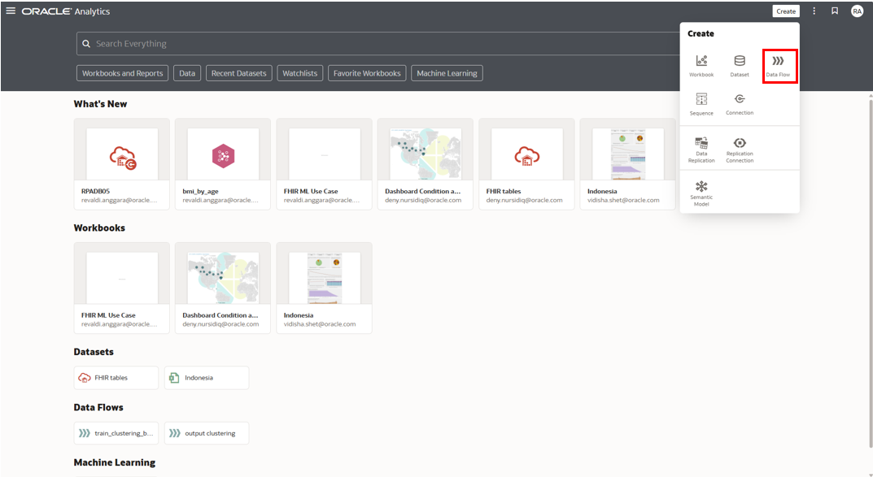
1. Go to the Oracle Analytics Cloud home page.
2. Click Create on the top-right corner.
3. Select Data Flow from the dropdown menu.
Use the Data Flow to:
Add and prepare datasets.
Apply transformations (cleaning, joining, filtering, etc.).
Add machine learning steps such as classification, regression, or clustering.Save the Data Flow to proceed with model training.
Copyright © 2025, Oracle and KEMENKES - Confidential

Slide 19
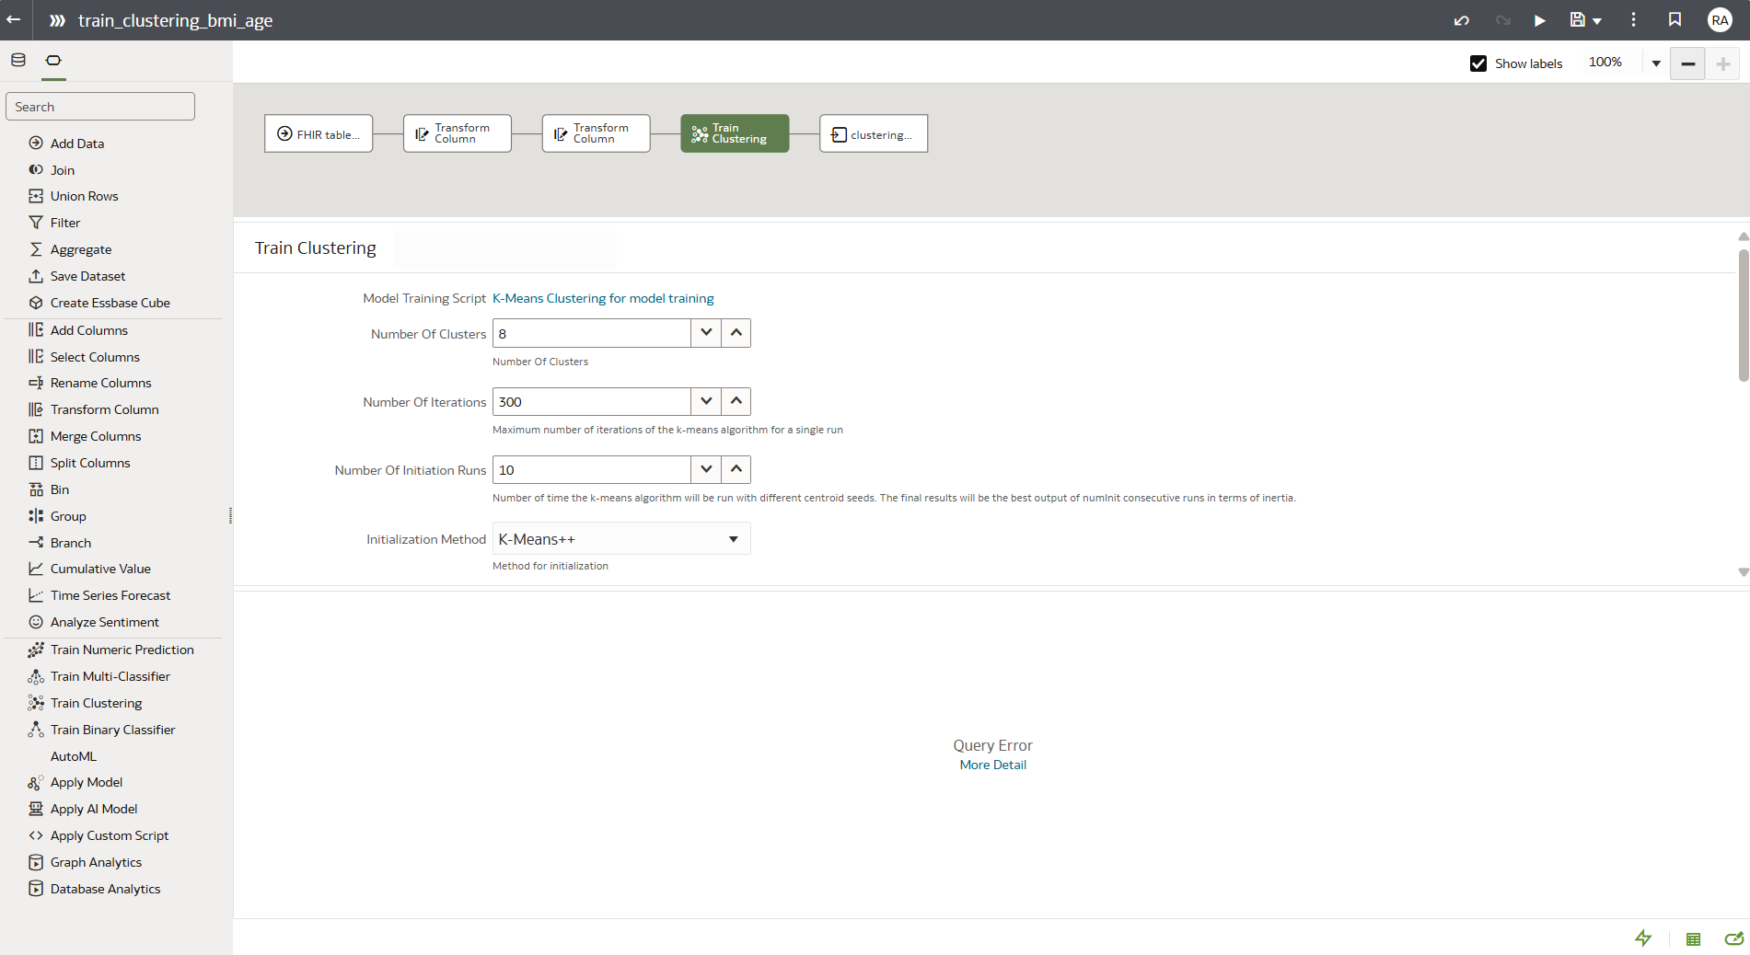

Copyright © 2025, Oracle and KEMENKES - Confidential

Slide 20
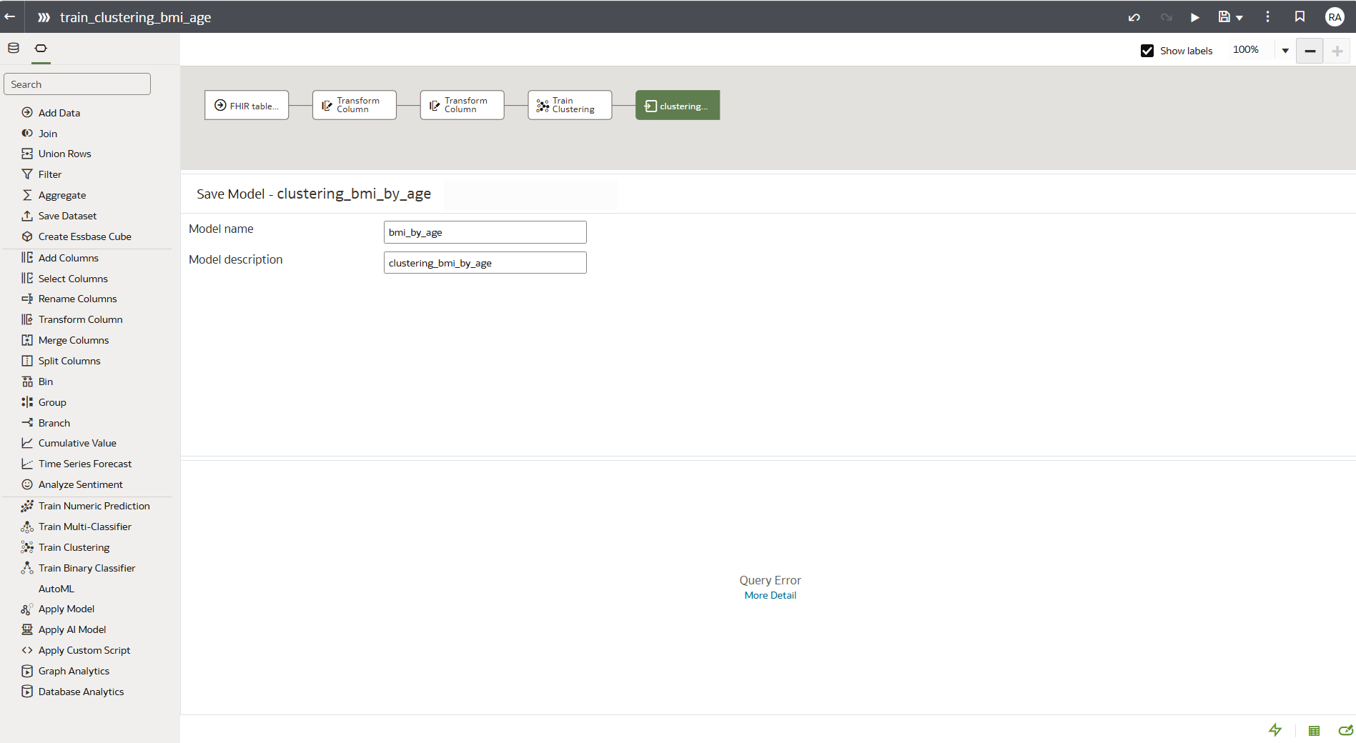

After training is complete, save your clustering model by entering a Model Name (e.g., bmi_by_age) and an optional Model Description (e.g., clustering_bmi_by_age).
This step ensures the trained model is stored and can be reused later for analysis or applied to new datasets. Click Save to finalize the process.
Copyright © 2025, Oracle and KEMENKES - Confidential

Slide 21
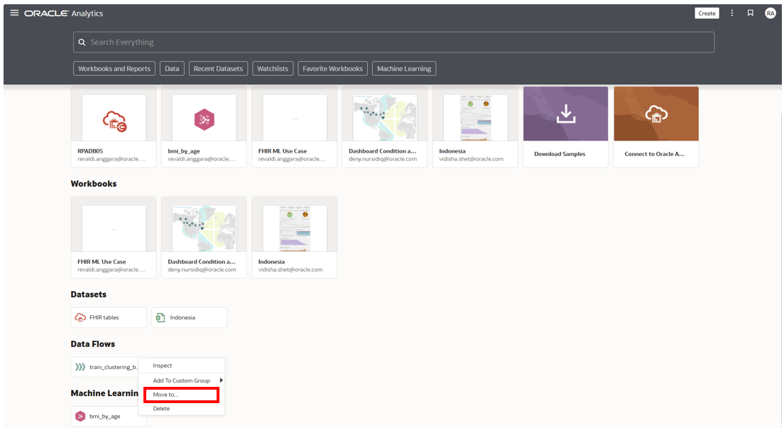
Go to the Machine Learning section on the Oracle Analytics Cloud home page.
Locate the saved model (e.g., bmi_by_age).
Right-click the model, then select Move to… to organize or share the model into another folder or workspace.
This allows the model to be easily accessed by other users or grouped with related assets.
Copyright © 2025, Oracle and KEMENKES - Confidential

Slide 22
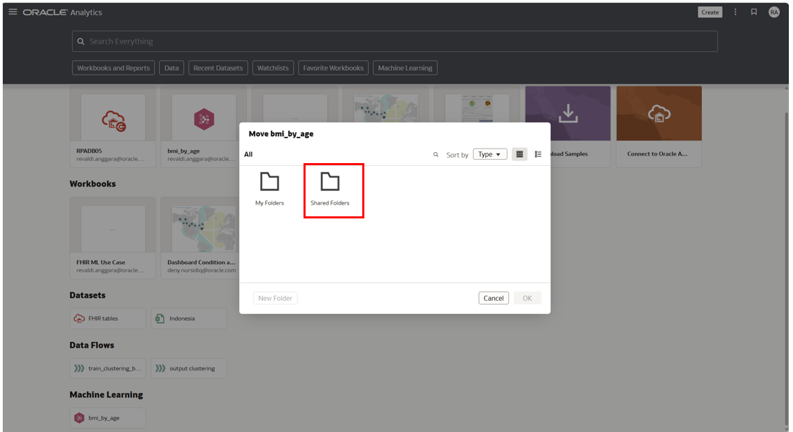
Copyright © 2025, Oracle and KEMENKES - Confidential

Slide 23
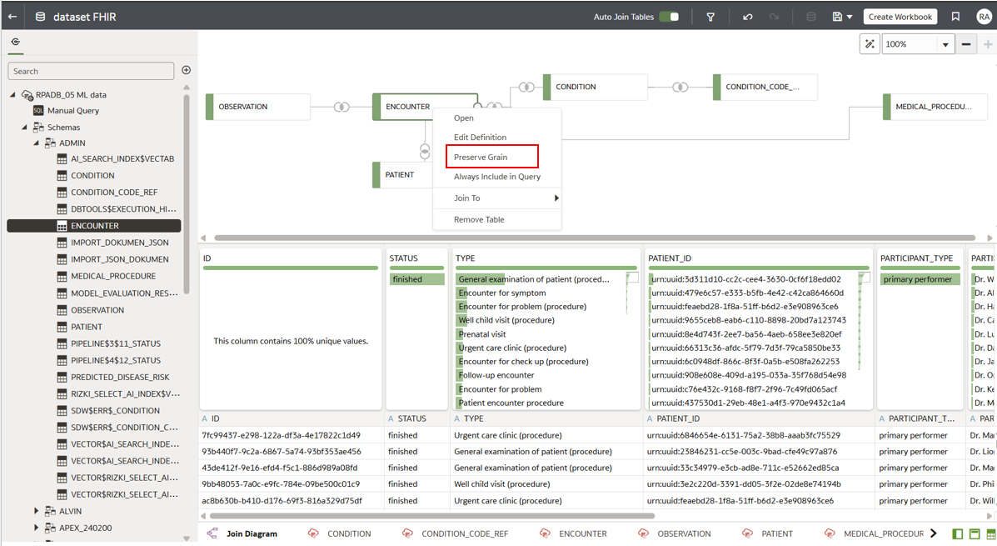
Set Preserve Grain in OAC
In Oracle Analytics Cloud Data Flow, right-click on the table that will serve as the main reference (e.g., ENCOUNTER) and select Preserve Grain. This step defines the grain of analysis and ensures consistency across joins. Enabling Preserve Grain is important for activating AI Insights, as it tells OAC which table should be treated as the primary level of detail during analysis.
Copyright © 2025, Oracle and KEMENKES - Confidential

Slide 24
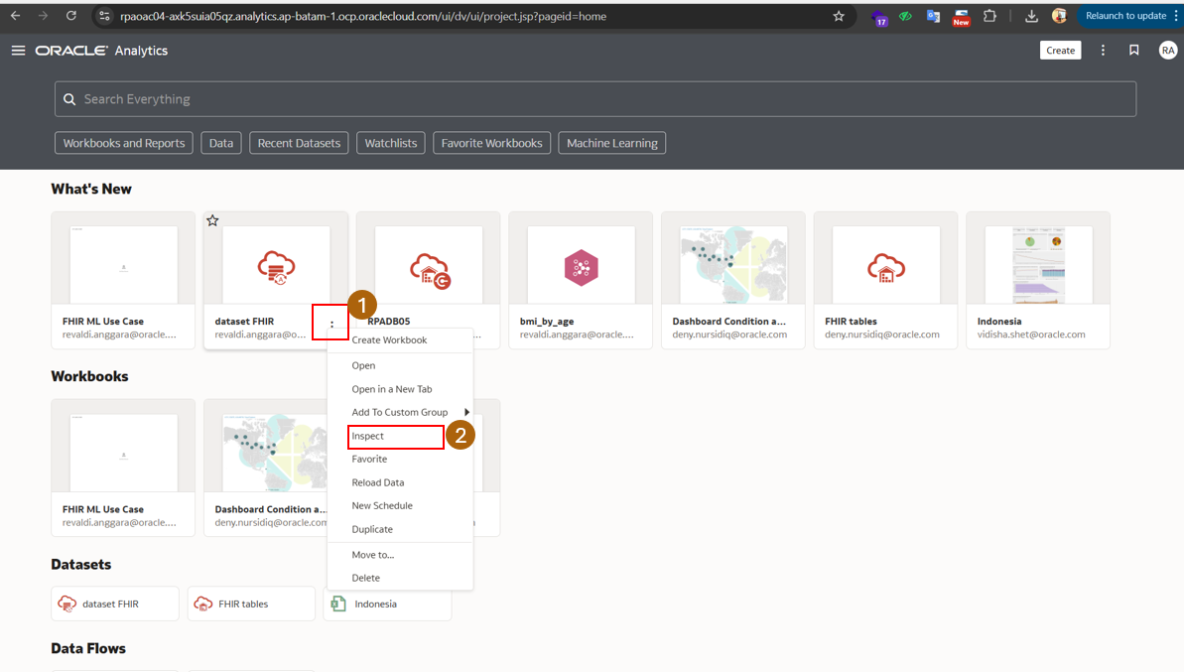
Inspecting the dataset ensures that the data is ready and well-understood before using the Chat with Data Visualization feature to generate insights and visualizations interactively.
Copyright © 2025, Oracle and KEMENKES - Confidential

Slide 25
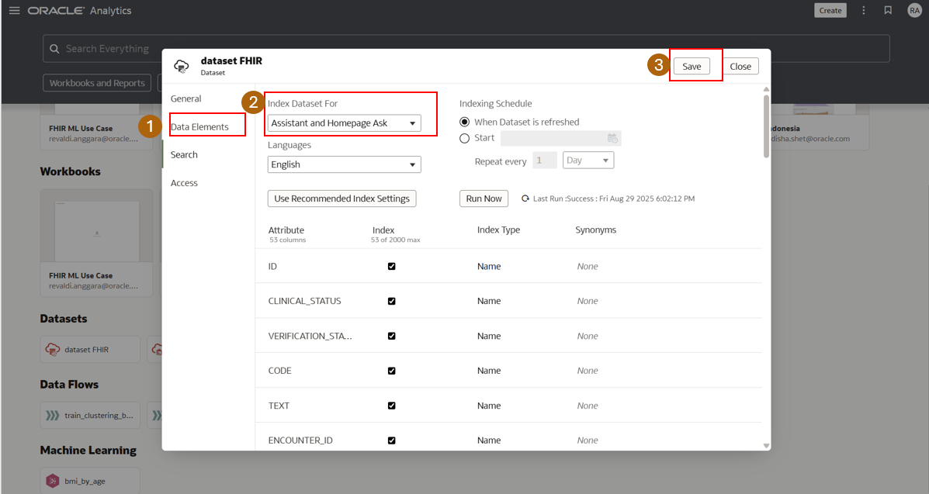
Open the dataset settings and go to the Data Elements tab.
Under Index Dataset For, select Assistant and Homepage Ask to enable the dataset for natural language queries (Chat with Data Visualization).
Click Save to apply the settings.
This configuration ensures that the dataset is indexed and available for interactive exploration using the assistant or chat interface in Oracle Analytics Cloud.
Copyright © 2025, Oracle and KEMENKES - Confidential

Slide 26
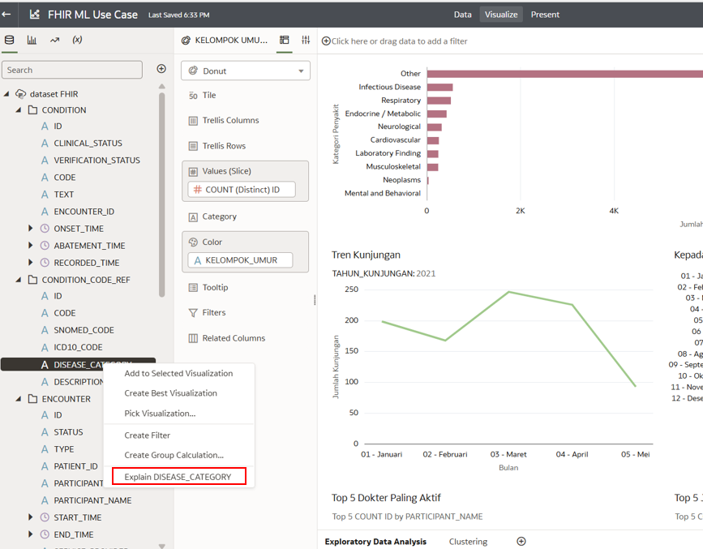
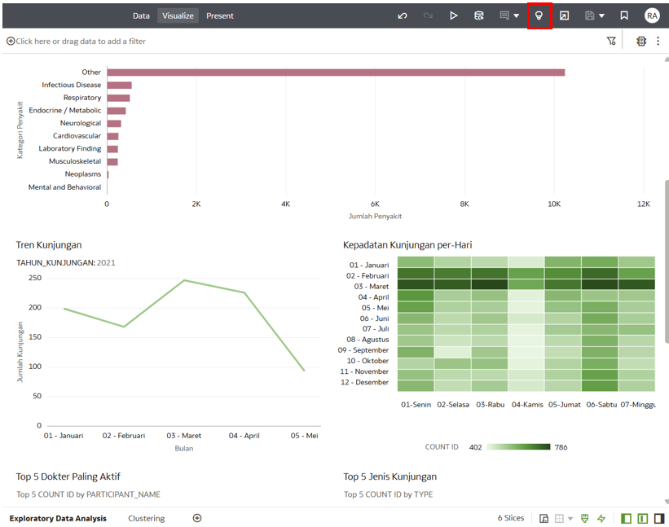
Copyright © 2025, Oracle and KEMENKES - Confidential

Slide 27
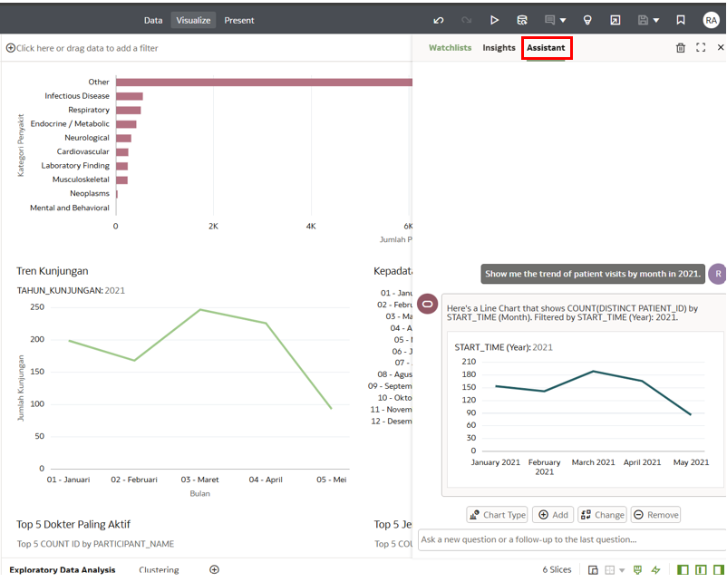
Sample Questions for Chat with Data Visualization
Show me the trend of patient visits by month in 2021.
Which day of the week has the highest number of patient visits?
List the top 5 most common visit types among patients.
Who are the top 5 most active doctors based on encounter count?
Show the distribution of disease categories among patients.
Copyright © 2025, Oracle and KEMENKES - Confidential

Slide 28

Better care.
Better outcomes.
Better together.

Slide 29


